Slide 1
Troubleshooting SQL Server
Greg Miller – Manager, Technical Services

Slide 2
A Little About Me

Slide 3

Greg Miller
Greg.Miller@tylertech.com
Product Support Manager
Past Roles:
JOTS Transport Operator
Dolphin Trainer
Dairy Queen Ice cream Artist
Training SQL Since: 1995
Adjunct Professor at Southern Maine Community College
Currently Working on PHD in Information Technology

Slide 4
Agenda
High Disk I/O
High CPU Utilization
Memory Mismanagement
Missing Indexes

Slide 5
“Process X is running slow. Can you fix it?"

Slide 6
High Disk I/O

Slide 7
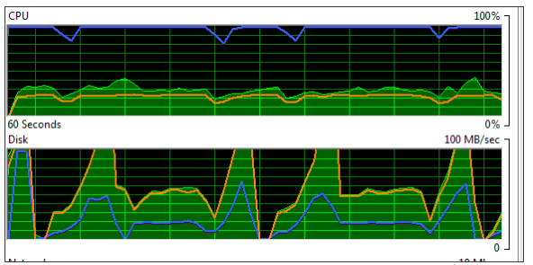
"Process X is running slow. Can you fix it?"
As the DBA, the first thing you do is to spin up Windows Resource Monitor and immediately notice an abnormal pattern of disk activity on the server.

Slide 8
Diagnosing Disk I/O Issues
Primary tool for investigating disk issues is Performance Monitor (PerfMon).
The key for performance is having the lowest latency possible and my guideline latency values for each of these counters are as follows:
Less than 10 ms = good performance
Between 10 ms and 20 ms = slow performance
Between 20 ms and 50 ms = poor performance
Greater than 50 ms = significant performance problem.

Slide 9
Diagnosing Disk I/O Issues
The testing options for all hard drives in Windows are found:
Performance Monitor: For Disk
Performance Monitor Options: Physical Disk
Avg. Disk sec/Queue Length
Avg. Disk sec/Read
Avg. Disk sec/Write
Measured in Milliseconds (ms)

Slide 10
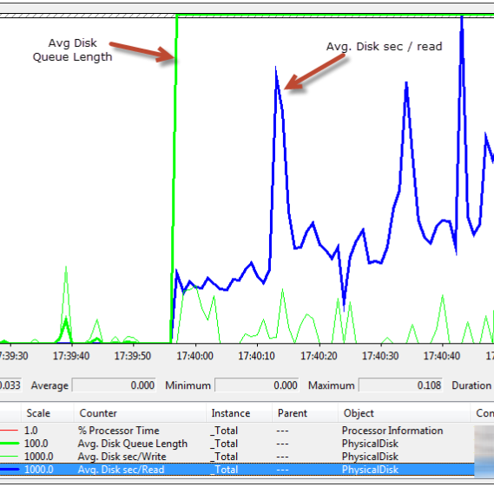
Performance Monitor
The Picture Suggests:
Periods of high latency associated with reading data from disk
Along with a sharp rise in the average disk queue length.
It seems that the disk subsystem is becoming a bottleneck; it is struggling to keep up with the number of requests.

Slide 11
Diagnosing Disk I/O Issues
In addition to the performance counters high wait times for:
PAGEIOLATCH_*
ASYNC_IO_COMPLETION
IO_COMPLETION
WRITELOG
Can be signs of disk I/O bottlenecks on the server.
To find out you need to querying the sys.dm_os_waiting_tasks dynamic management view (DMV)
It reveals any currently-executing requests that are waiting for resources, joining to other DMVs for details of the associated sessions and requests.

Slide 12
Diagnosing Disk I/O Issues
SELECT dm_ws.wait_duration_ms,
dm_ws.wait_type,
dm_es.status,
dm_t.TEXT,
dm_qp.query_plan,
dm_ws.session_ID,
dm_es.cpu_time,
dm_es.memory_usage,
dm_es.logical_reads,
dm_es.total_elapsed_time,
dm_es.program_name,
DB_NAME(dm_r.database_id) DatabaseName,
-- Optional columns
dm_ws.blocking_session_id,
dm_r.wait_resource,
dm_es.login_name,
dm_r.command,
dm_r.last_wait_type
FROM sys.dm_os_waiting_tasks dm_ws
INNER JOIN sys.dm_exec_requests dm_r ON dm_ws.session_id = dm_r.session_id
INNER JOIN sys.dm_exec_sessions dm_es ON dm_es.session_id = dm_r.session_id
CROSS APPLY sys.dm_exec_sql_text (dm_r.sql_handle) dm_t
CROSS APPLY sys.dm_exec_query_plan (dm_r.plan_handle) dm_qp
WHERE dm_es.is_user_process = 1
GO

Slide 13
Diagnosing Disk I/O Issues
You need to look for the wait types experienced by current queries
We look for the ones that appeared high in the historical list to see if they also appear high in this historical list
In this example, we see two wait types, the query text and plans for the associated requests.

Slide 14
Diagnosing Disk I/O Issues
We are often investigating a problem retrospectively
This means we need to interrogate the sys.dm_os_wait_stats DMV
This will include all the "running totals" for all wait types
They are accumulated across all requests since the server was last restarted

Slide 15
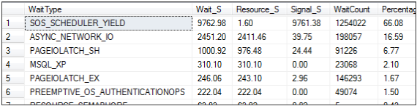
Diagnosing Disk I/O Issues
While the script for this is too big to show here you will see it in your lab
What you are looking for are the wait types experienced by current queries
You are looking for the ones that also appeared high in previous diagnostic queries
You see that ASYNC_NETWORK_IO and PAGEIOLATCH_SH show up again

Slide 16
Diagnosing Disk I/O Issues
ASYNC_NETWORK_IO indicates the client cannot process the data quickly enough
In general, watch out for this wait type as a warning of inefficient data processing on the client-side.
PAGEIOLATCH_SH wait type, meaning that read requests had to wait to obtain a latch, in order to read in from disk pages not held in the buffer cache.
This may indicate that the problem in under-powered or misconfigured disks: if the disk subsystem cannot return pages quickly enough then it could lead to a long queue of requests waiting to obtain pages, and latch contention.
However, if we suspect a disk IO bottleneck, what is the root cause?
A useful next step is to find out more about the IO workload.
For example, are any databases and files particular "hotspots" of IO activity?

Slide 17
Diagnosing Disk I/O Issues
The next step is to look at this workload
To do this we need to look at the Virtual file statistics
You need to query the sys.dm_io_virtual_file_stats DMV
This provides insight into IO activity on a SQL Server instance
It is especially useful for revealing the distribution of the IO load is distributed across the various databases.

Slide 18
Diagnosing Disk I/O Issues
--Get I/O utilization by database (Query 31) (IO Usage By Database)
WITH Aggregate_IO_Statistics
AS
(SELECT DB_NAME(database_id) AS [Database Name],
CAST(SUM(num_of_bytes_read + num_of_bytes_written)/1048576 AS DECIMAL(12, 2)) AS io_in_mb
FROM sys.dm_io_virtual_file_stats(NULL, NULL) AS [DM_IO_STATS]
GROUP BY database_id)
SELECT ROW_NUMBER() OVER(ORDER BY io_in_mb DESC) AS [I/O Rank], [Database Name], io_in_mb AS [Total I/O (MB)],
CAST(io_in_mb/ SUM(io_in_mb) OVER() * 100.0 AS DECIMAL(5,2)) AS [I/O Percent]
FROM Aggregate_IO_Statistics
ORDER BY [I/O Rank] OPTION (RECOMPILE);

Slide 19

Diagnosing Disk I/O Issues
This indicates that the SQLMonTest database is an IO hotspot.
These statistics are accumulated since the last instance restart, but unlike wait statistics cannot be reset manually.

Slide 20
Diagnosing Disk I/O Issues
Now that we have narrowed down the problem to one or two databases
The next logical question is: which requests are causing all this IO activity on these databases?
The following script will help diagnose this

Slide 21
Diagnosing Disk I/O Issues
SELECT TOP 10
t.text ,
execution_count ,
statement_start_offset AS stmt_start_offset ,
sql_handle ,
plan_handle ,
total_logical_reads / execution_count AS avg_logical_reads ,
total_logical_writes / execution_count AS avg_logical_writes ,
total_physical_reads / execution_count AS avg_physical_reads
FROM sys.dm_exec_query_stats AS s
CROSS APPLY sys.dm_exec_sql_text(s.sql_handle) AS t
WHERE DB_NAME(t.dbid) = ‘Master'
ORDER BY avg_physical_reads DESC;

Slide 22
Diagnosing Disk I/O Issues
This allows us to examine the query execution statistics stored in sys.dm_exec_query_stats,
It also shows us the queries with the highest total physical reads, and their associated plan handles.

Slide 23
High CPU Utilization

Slide 24
Diagnosing High CPU Utilization Issues
There is a high CPU issue reported on SQL Server machine
First we need to determine whether the issue was caused by SQL Server or some process outside of SQL.
We need to narrow down the high CPU problem to the lowest possible level or the component which is causing high CPU.
You can do this by exploring ring buffers to get historical data
You can query and the history available on the system at any point in time.
The following script will help you get this information

Slide 25
Diagnosing High CPU Utilization Issues
DECLARE @ms_ticks_now BIGINT
SELECT @ms_ticks_now = ms_ticks
FROM sys.dm_os_sys_info;
SELECT TOP 15 record_id
,dateadd(ms, - 1 * (@ms_ticks_now - [timestamp]), GetDate()) AS EventTime
,SQLProcessUtilization
,SystemIdle
,100 - SystemIdle - SQLProcessUtilization AS OtherProcessUtilization
FROM (
SELECT record.value('(./Record/@id)[1]', 'int') AS record_id
,record.value('(./Record/SchedulerMonitorEvent/SystemHealth/SystemIdle)[1]', 'int') AS SystemIdle
,record.value('(./Record/SchedulerMonitorEvent/SystemHealth/ProcessUtilization)[1]', 'int') AS SQLProcessUtilization
,TIMESTAMP
FROM (
SELECT TIMESTAMP
,convert(XML, record) AS record
FROM sys.dm_os_ring_buffers
WHERE ring_buffer_type = N'RING_BUFFER_SCHEDULER_MONITOR'
AND record LIKE '%<SystemHealth>%'
) AS x
) AS y
ORDER BY record_id DESC

Slide 26
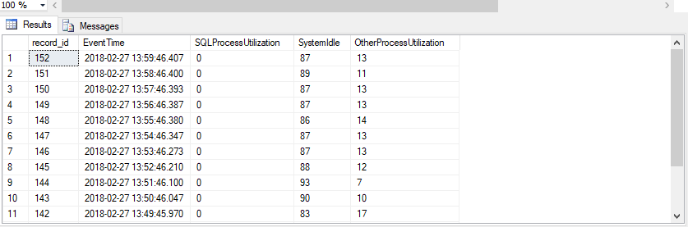
Diagnosing High CPU Utilization Issues
The query above shows 15 minutes worth of data.
Shows all the SQL processes that need to be examined

Slide 27
Diagnosing High CPU Utilization Issues
Sometimes it’s good to look at all queries executed so far and get the top CPU consumers from the query plans available in plan cache.
The CPU might be normal at this point, but we want to get historical data.
This can be achieved using query stats dynamic management views.
The following query gives us an overview of cached batches or procedures which have used most CPU historically:

Slide 28
Diagnosing High CPU Utilization Issues
select top 50
sum(qs.total_worker_time) as total_cpu_time,
sum(qs.execution_count) as total_execution_count,
count(*) as number_of_statements,
qs.plan_handle
from
sys.dm_exec_query_stats qs
group by qs.plan_handle
order by sum(qs.total_worker_time) desc
SELECT query_plan FROM sys.dm_exec_query_plan (0x06001D009FE38431400399D4000000000000000000000000);
To convert XML to graphical view, save XML file with
extension .sqlplan & open it with SSMS

Slide 29
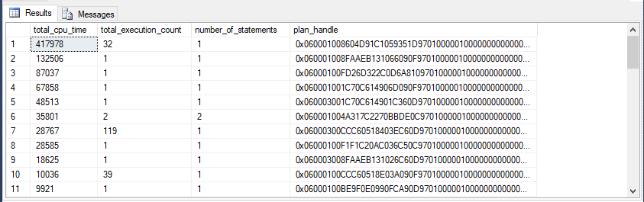
Diagnosing High CPU Utilization Issues

Slide 30
Memory Mismanagement

Slide 31
Diagnosing Memory Mismanagement Issues
The testing options for all memory in Windows are found in Performance Monitor under the Memory options:
Measured in Milliseconds (ms)
Performance Monitor Options
Memory – Available MBytes
SQLServer: Buffer Manager – Page Life Expectancy
SQLServer: Memory Manager – Memory Grants Pending
SQLServer: Memory Manager – Target Server Memory
SQLServer: Memory Manager – Total Server Memory
SQLServer: SQL Statistics – Batch Requests/sec
SQLServer: SQL Statistics – Compilations/sec

Slide 32
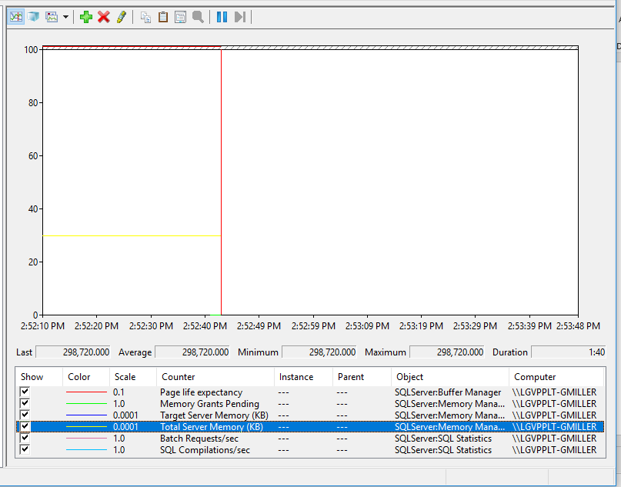
Diagnosing Memory Mismanagement Issues

Slide 33
Diagnosing Memory Mismanagement Issues
If your server is slow and you’ve got less than 64GB of memory. Then allocate additional RAM.
If Memory Grants Pending is averaging over 0. Then allocate additional RAM.
If Compiles/Sec is over 10% of Batch Requests/Sec, SQL Server may not be able to cache execution plans. Then allocate additional RAM
If Page Life Expectancy is low. Then allocate additional RAM
Notes:
You need to make a case that it is smarter to buy $500 worth of memory rather than spend days struggling with a problem and making risky changes to your server.
Sure, the organization is going to argue against you – that’s their job, and it’s your job to clearly explain the pros and cons of each side.
Queries can’t even start because they can’t get enough memory. You may have queries that have incorrect memory grants, or you may just desperately need more RAM.
This causes increased CPU use and slower queries. There’s a lot of gotchas with this one, though – now the hard work starts, because you have to spend time analyzing your workload to see if the execution plans can even be reused.
, you may need memory to cache more data pages.

Slide 34
The PowerPoint Punishment is Over!
Questions???

Slide 35

Take your class survey – This is important!
Survey available in mobile app
Access your survey from My Agenda or the Session menu, then click on the bottom right SHOUT OUT icon.

